Slide 1

POTOMAC SHORES
TENNIS COURT VOTE
SPECIAL MEETING #2

Slide 2
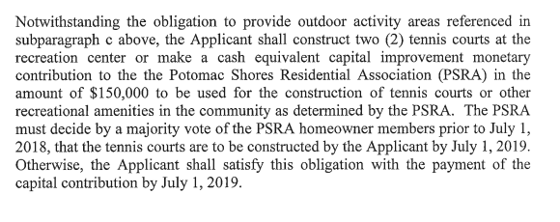
SUMMARY OF PROFFER

Slide 3
Background Information
THE ORIGINAL PROFFER AGREEMENT PER THE 2013 REZONING ESTABLISHED THAT THE DEVELOPER WOULD PROVIDE A MINIMUM 10,000 SF CLUBHOUSE FACILITY, 2 SWIMMING POOLS, A TOT LOT & 4 TENNIS COURTS. THIS PROFFER WAS ESTABLISHED PRIOR TO ANY DETAILED DESIGN WORK FOR THE REC CENTER.
IN JUNE, 2013 AN ARCHITECTURAL FIRM WAS HIRED TO DESIGN THE REC CENTER, AND THEY CAME UP WITH THE SOCIAL BARN, REC BARN, POOL BARN THEME, WHICH INCLUDED A COMMUNITY GARDEN, MARKET SQUARE, GREENHOUSE, TERRACED POOL VIEWING AREA, EVENT LAWN, ETC. DURING THIS DESIGN PHASE, FEEDBACK PROVIDED BY HOA MANAGEMENT WAS THAT THE POPULARITY OF TENNIS HAD BEEN ON THE DECLINE FOR YEARS AND TENNIS COURTS AT EXISTING COMMUNITIES WERE CONSISTENTLY UNUSED. IN CONSIDERATION OF THESE TWO THINGS, A DECISION WAS MADE TO REDUCE THE NUMBER OF COURTS FROM FOUR TO TWO (DUE TO SPACE CONSIDERATIONS) AND ULTIMATELY TO LET THE RESIDENTS MAKE THE DECISION, AT A FUTURE DATE WHEN THE RESIDENT POPULATION WOULD BE MORE SIGNIFICANT, AS TO WHETHER THEY WANTED COURTS AT ALL.
IN 2014 A PROFFER AMENDMENT WAS SUBMITTED TO PRINCE WILLIAM COUNTY AND A NEW AGREEMENT WAS REACHED THAT ALLOWED THE DEVELOPER TO BUILD THEIR PLAN WITH THE CAVEAT THAT AT A FUTURE DATE THE RESIDENTS WOULD VOTE TO EITHER ACCEPT $150,000 TO USE TOWARDS OTHER AMENITIES OR TO HAVE THE DEVELOPER CONSTRUCT TWO TENNIS COURTS.

Slide 4
2013 Conceptual Plan

Slide 5
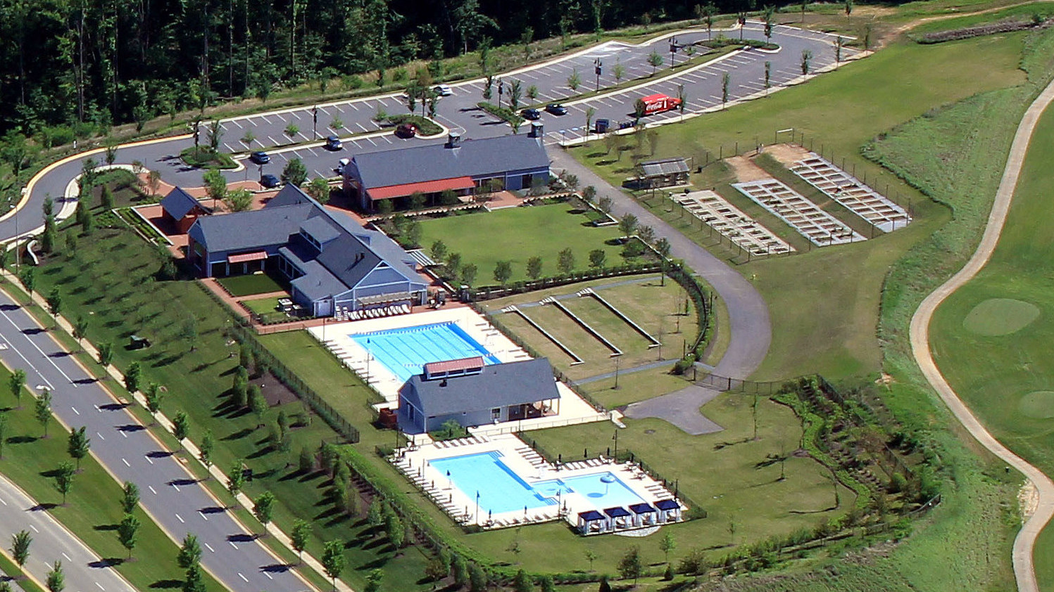
May 2018 Aerial Photo

Slide 6
Summary of Rec Center Amenities
2013 Original Proffer
2015 Amended Proffer
Actual
Minimum 10,000 sf Clubhouse Facility that includes
Minimum 10,000 sf Clubhouse Facility that includes
Over 14,000 sf in 3 separate buildings with high end
an Exercise/Fitness Room and Multi Purpose Room
an Exercise/Fitness Room and Multi Purpose Room,
equipment and finishes.
which may be more than 1 building
2 Swimming Pools, one of which shall be a minimum
2 Swimming Pools, one of which shall be a minimum
2 Swimming Pools which include an 8 Lane X 25
6 lanes and 25 yards in length
6 lanes and 25 yards in length
yards lap pool and large family pool with integrated
kiddie pool area.
Outdoor Activity Area(s) that may include any of the
following: i) community garden, ii)
i) Greenhouse, ii) Community Garden, iii) Event
Tot Lot
greenhouse/potting shed iii), courts (volleyball,
Lawn, iv) Tiered Lawn Seating area for lap pool, v)
tennis, bocce, croquet), iv) Tot Lot, v) other similar
Market Pavillion
types of activities
Option of 2 Tennis Courts to be approved by
majority vote of the PSRA homeowners by
July 1, 2018 or $150,000 cash contribution.
Tennis Courts to be approved by
4 Tennis Courts
a majority vote of the PSRA homeowners by July 1,
2018 or $150,000 cash contribution.

Slide 7
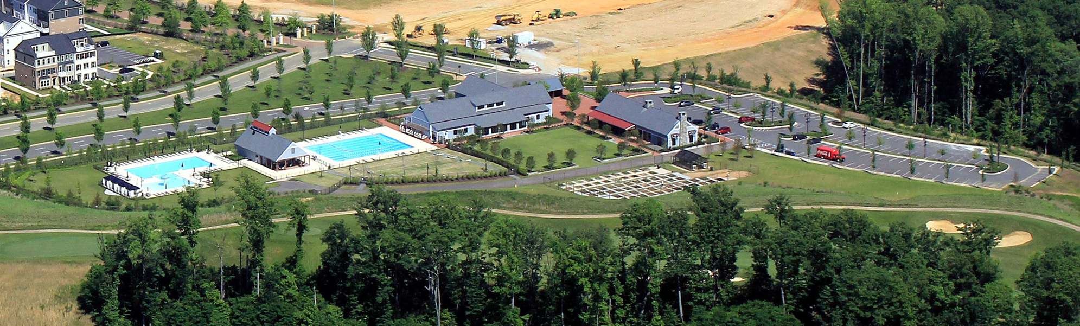
May, 2018 Aerial Photo

Slide 8
Proposed Tennis Courts Location

Slide 9
THINGS TO CONSIDER WHEN VOTING
THE SCHEMATIC DESIGN OF THE MIDDLE SCHOOL INCLUDES THREE TENNIS COURTS AND A BASKETBALL COURT THAT WILL BE COUNTY OPERATED AND MAINTAINED
SHOULD THE HOA VOTE TO ACCEPT THE COURTS THERE WILL BE MAINTENANCE COSTS AND SHOULD THE COURTS NOT BE UTILIZED IT WILL BE COSTLY TO REMOVE THE COURTS AND REPLACE WITH AN ALTERNATE AMENTITY
SHOULD THE HOA VOTE TO ACCEPT THE $150,000 CAPITAL CONTRIBUTION, THE BOARD WILL APPOINT AN ADHOC COMMITTEE TO RESEARCH IDEAS ON HOW TO USE THE FUNDS FOR OTHER RECREATIONAL AMENTITIES

Slide 10
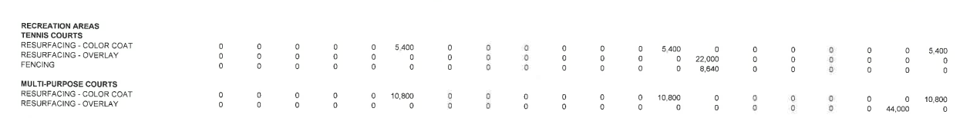
EXAMPLE MAINTENANCE COURT COSTS
**THIS IS AN EXAMPLE ONLY OF A COMMUNITY WHO HAD ONE TENNIS COURT AND ONE MULTI-PURPOSE COURT

Slide 11
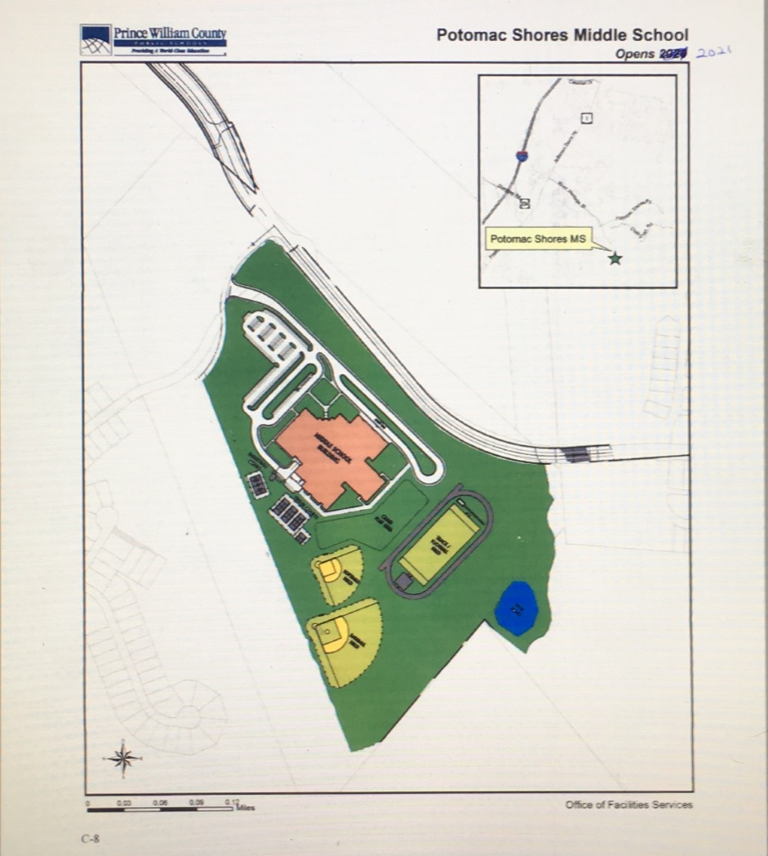
SCHEMATIC DESIGN OF THE MIDDLE SCHOOL

Slide 12
YOUR VOTE
ONE VOTE PER HOUSEHOLD
HAVE THE DEVELOPER CONSTRUCT TWO TENNIS COURTS AT THE RECREATION CENTER
OR
- ACCEPT $150,000 CAPITAL CONTRIBUTION FROM DEVELOPER FOR USE BY THE ASSOCIATION TO DECIDE UPON AT A LATER DATE

Slide 13
CLOSING NOTES
EACH HOMEOWNER RECEIVED A PROXY CARD FOR VOTING IN ABSENCE
A MAJORITY VOTE IS REQUIRED BY THE COMMUNITY, IF THIS REQUIREMENT IS NOT MET, THE DEVELOPER WILL EXECUTE THE CAPITAL CONTRIBUTION
QUESTIONS SHOULD BE DIRECTED TO SCRUZ@CMC-MANAGEMENT.COM ONLY

