Slide 1

TENNIS COURT VOTE SPECIAL MEETING POTOMAC SHORES

Slide 2
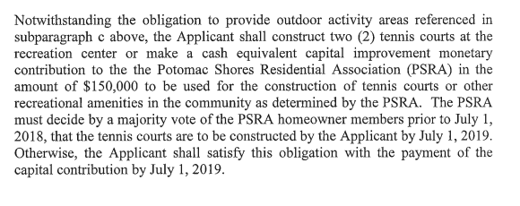
SUMMARY OF PROFFER

Slide 3
YOUR VOTE
ONE VOTE PER HOUSEHOLD
HAVE THE DEVELOPER CONSTRUCT TWO TENNIS COURTS AT THE RECREATION CENTER
OR
- ACCEPT $150,000 CAPITAL CONTRIBUTION FROM DEVELOPER FOR USE BY THE ASSOCIATION TO DECIDE UPON AT A LATER DATE
**THE EXACT LOCATION OF THE TENNIS COURTS HAS NOT BEEN DETERMINED

Slide 4
THINGS TO CONSIDER WHEN VOTING
THE SCHEMATIC DESIGN OF THE MIDDLE SCHOOL INCLUDES THREE TENNIS COURTS AND A BASKETBALL COURT THAT WILL BE COUNTY OPERATED AND MAINTAINED
SHOULD THE HOA VOTE TO ACCEPT THE COURTS THERE WILL BE MAINTENANCE COSTS AND SHOULD THE COURTS NOT BE UTILIZED IT WILL BE COSTLY TO REMOVE THE COURTS AND REPLACE WITH AN ALTERNATE AMENTITY
SHOULD THE HOA VOTE TO ACCEPT THE $150,000 CAPITAL CONTRIBUTION, THE BOARD WILL APPOINT AN ADHOC COMMITTEE TO RESEARCH IDEAS ON HOW TO USE THE FUNDS FOR OTHER RECREATIONAL AMENTITIES

Slide 5
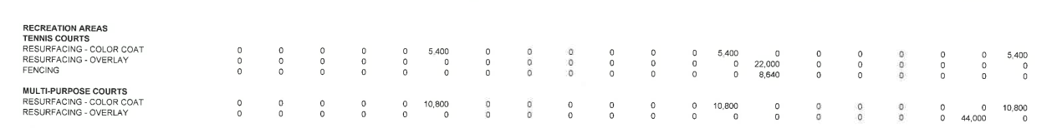
EXAMPLE MAINTENANCE COURT COSTS
**THIS IS AN EXAMPLE ONLY OF A COMMUNITY WHO HAD ONE TENNIS COURT AND ONE MULTI-PURPOSE COURT

Slide 6
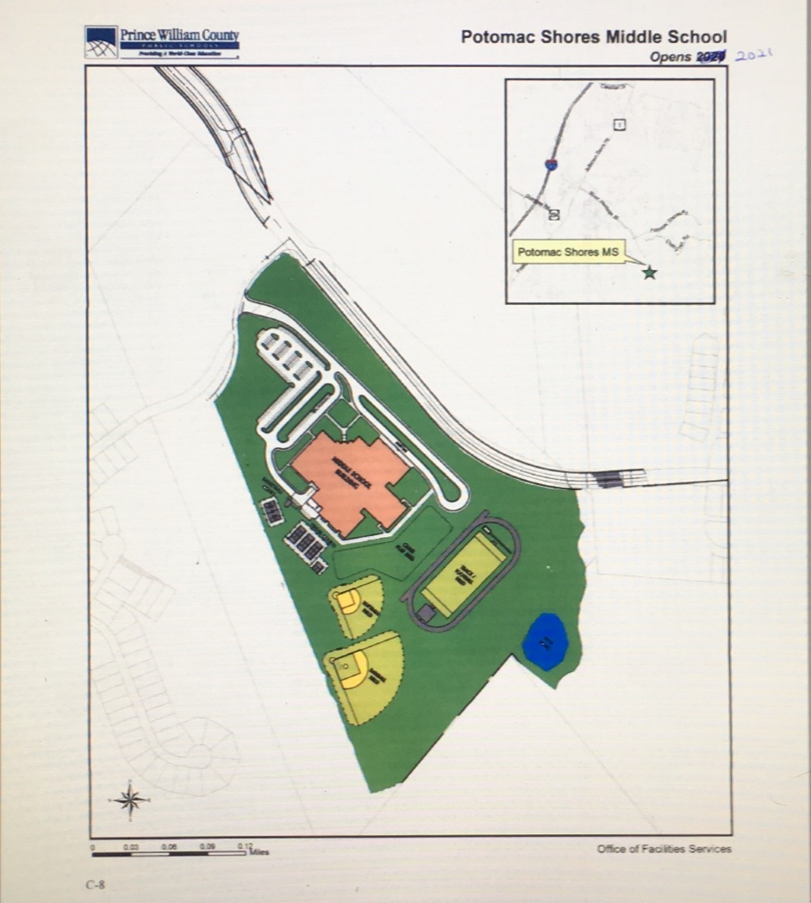
SCHEMATIC DESIGN OF THE MIDDLE SCHOOL

Slide 7
CLOSING NOTES
EACH HOMEOWNER RECEIVED A PROXY CARD FOR VOTING IN ABSENCE
A 51% VOTE IS REQUIRED BY THE COMMUNITY, IF THIS REQUIREMENT IS NOT MET, THE DEVELOPER WILL EXECUTE THE
THE CAPITAL CONTRIBUTION
QUESTIONS SHOULD BE DIRECTED TO SCRUZ@CMC-MANAGEMENT.COM ONLY

